Slide 1
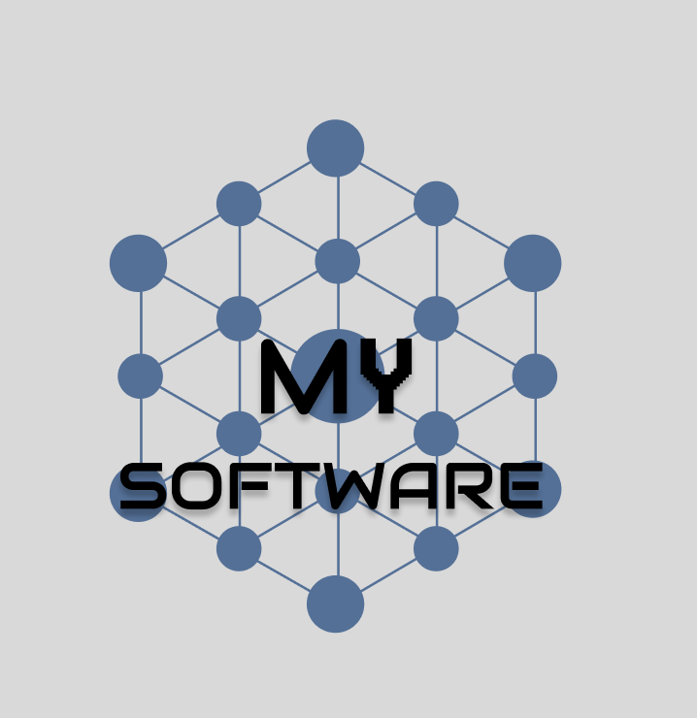
M.Y Software Initial Client Meeting

Slide 2
Meet The Team!

Slide 3
Meet The Team!
Jeremy
(Lead Project manager / Design and Art)
Contributions : Project Management , Design , Company Identity

Slide 4
Meet The Team!
Cameron
(Deputy Lead / Lead Developer)
Contributions: Development , Wireframes , Client Interaction

Slide 5
Meet The Team!
Tony
(Art and Design Lead)
Contributions: Documentation , Design

Slide 6
Initial Proposition

Slide 7
Initial Proposition
A web app with multiple layers of functionality:
A mood tracking page
A list of small easy things to do for your mental health(eg, small articles on meditation) (can collect currency by reading to to unlock items)
A tamgochi / pet keeping style game designed to help calm the user

Slide 8
Why Have We Chosen This As A Project?

Slide 9
Initial Proposition
It has been shown that caring for pets does significantly increase quality of life for both healthy and mentally ill patients
  Scoresby KJ, Strand EB, Ng Z, Brown KC, Stilz CR, Strobel K, Barroso CS, Souza M. Pet Ownership and Quality of Life: A Systematic Review of the Literature. Vet Sci. 2021 Dec 16;8(12):332. doi: 10.3390/vetsci8120332. PMID: 34941859; PMCID: PMC8705563.

Slide 10
Initial Proposition
Keeping track of peoples mood and keywords allows for better recommendation of methods for managing or keeping moods high
  This is linked with the recommended articles page which may be influenced by reports from the mood tracker

Slide 11
Website Prototype

Slide 12
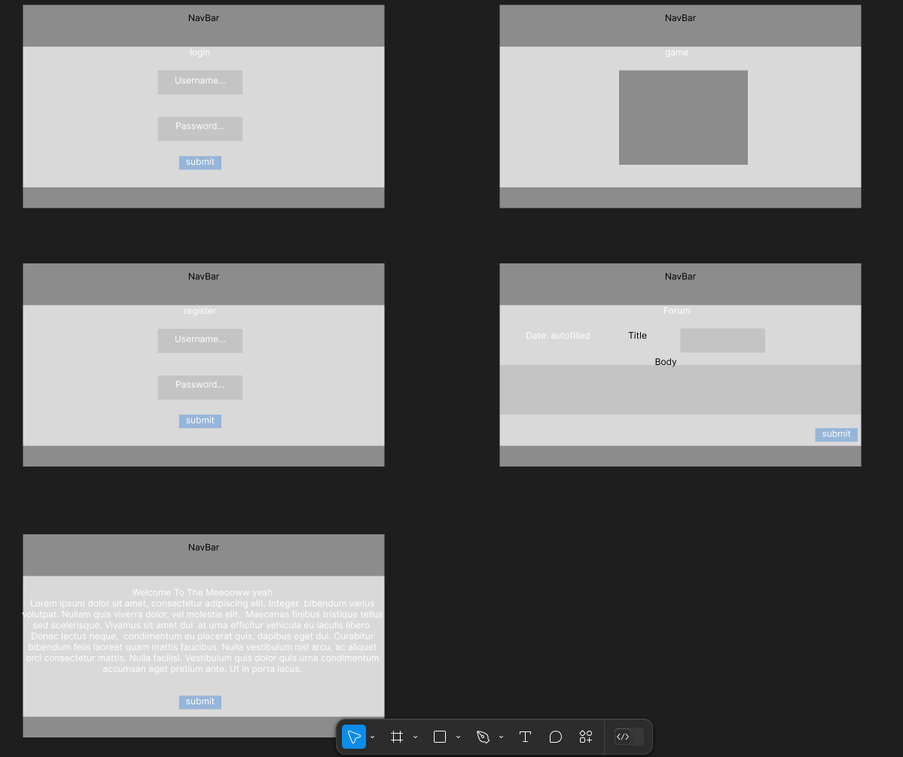
Prototypes

Slide 13
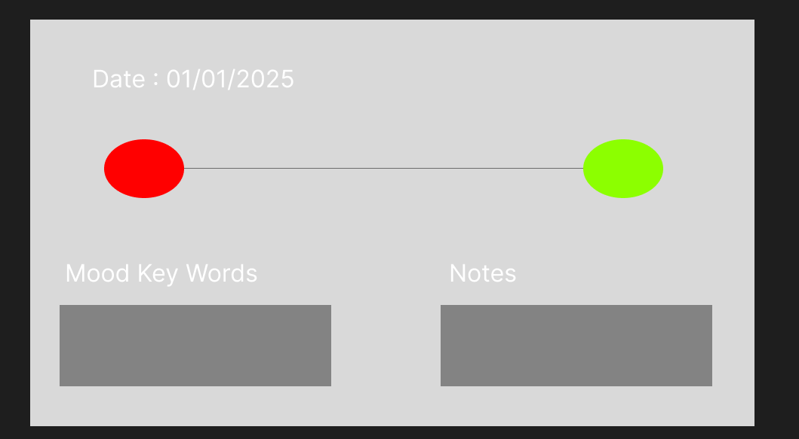
Prototypes

Slide 14
Live Demo
Login System Developed through to database that will be able to store player progress and any mood tracker data
The website is build on the React framework with and ExpressJS API(allows the website to talk to the database) with a SQLite database

Slide 15
Any Questions?

Slide 16
Questions From Us
  Based on our prototypes are there any features you can see being changed or added?
  Is there a specific user interaction you have in mind

Slide 17
Questions From Us
  Any design preferences for the company (eg, stick to house identity)?
  Must haves for the software , what do you see as crucial for the success of the prototype?

